Slide 1

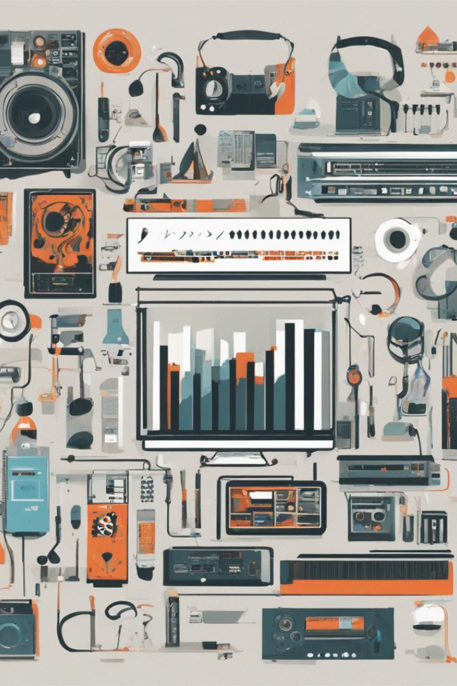
Blockchain In Music Industry
Blockchain technology has the potential to transform the music industry. Let's explore what blockchain is, how it can be applied to music, and its benefits and limitations.
RC
by Romit Chattopadhyay

Slide 2
The Basics: What is Blockchain?
Decentralization
Immutability
Transparency
Blockchain is a decentralized, distributed ledger that allows for secure peer-to-peer transactions without the need for intermediaries.
The information entered on a blockchain cannot be altered or deleted.
Transactions on a blockchain are transparent and can be viewed by anyone.

Slide 3

Applying Blockchain to Music
1
Royalty Payments
Blockchain can be used to automatically distribute royalties to musicians, songwriters, and producers.
2
Musical Licensing
Blockchain can simplify the music licensing process and make it more efficient.
3
Smart Contracts
Smart contracts can be used to automate music transactions such as licensing and royalty payments.

Slide 4



Benefits of Using Blockchain in Music
Transparency
Efficency
Security
Artists can view their earnings in real-time and track where their music is being played.
Blockchain automates payment processing, increasing efficiency and saving time and money.
Blockchain provides secure, tamper-proof transactions, eliminating the need for intermediaries such as record labels.

Slide 5
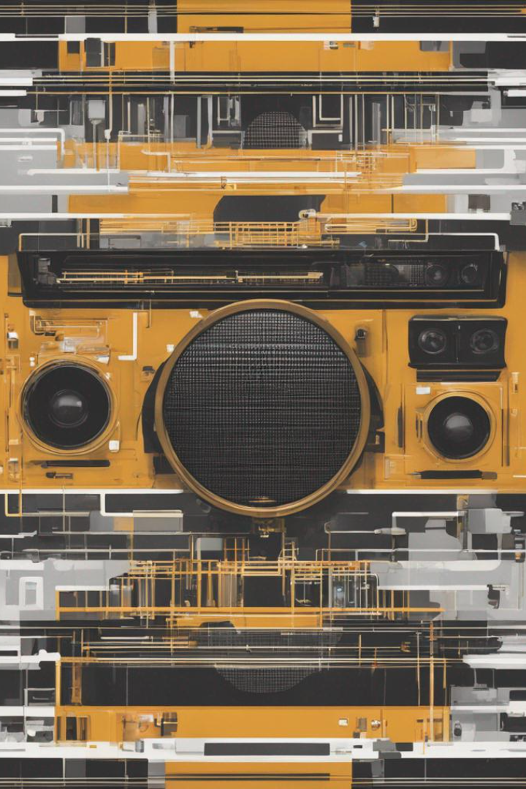
Challenges and Limitations of Implementing Blockchain in Music
1
Adoption
2
Interoperability
The overall adoption of blockchain technology in the music industry may be slow due to resistance from some industry stakeholders.
Interoperability between different blockchain systems is necessary for the technology to reach its full potential in the music industry.
3
Data Entry
Errors in data entry can result in incorrect distribution of royalties, and can be difficult to correct once entered on the blockchain.

Slide 6
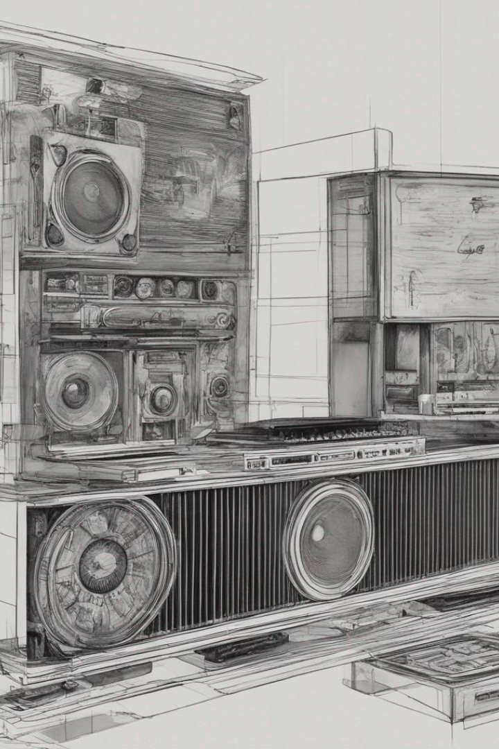
Real-World Examples of Blockchain in Music
Ujo Music
Choon
Ujo Music is a blockchain-based music platform that empowers artists, allowing them to maintain ownership of their music and facilitate direct payments from fans.
Choon is a blockchain-based music streaming platform that uses smart contracts to distribute revenue to artists, producers, and labels in real-time.

Slide 7
Future Potential of Blockchain in Music
NFTs and Tokenization
Increased Efficiency
Global Collaboration
Blockchain has the potential to increase efficiency across the entire music industry supply chain, from distribution to promotion.
Blockchain could facilitate easier collaboration between artists and producers from around the world, and reduce the complexity and costs associated with cross-border transactions.
Blockchain-based NFTs and tokenization could enable new ways for artists to monetize their music and receive investment from fans.

Slide 8
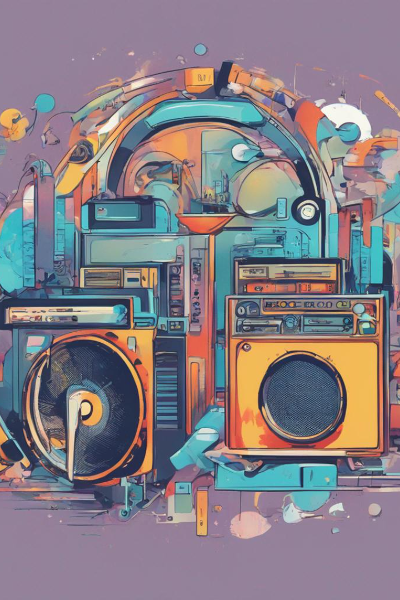
Conclusion
In conclusion, blockchain technology has the potential to revolutionize the music industry. As adoption increases, we can expect to see new business models, new ways for artists to monetize their work, and increased transparency and efficiency in the music industry.

